Slide 1

ECE477 Midterm Design Review: Team 3
<Add team picture or relevant project picture here>

Slide 2
Outline
Project Overview
Major Components
Block Diagram
Packaging Design
Electrical Schematic
PCB Layout
Prototyping Progress
Software Development Status
Project Timeline
Questions

Slide 3
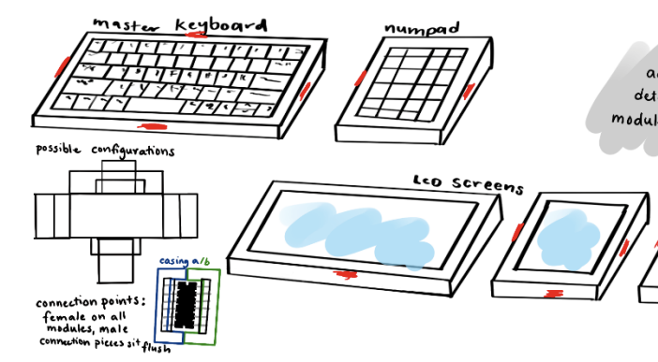
Project Overview
Not your average Keyboard (NYAKB)
NYAKB is a newcomer in the growing mechanical keyboard community that includes a high quality, phone sized LCD screen that will display various information, and can interact with the keyboard itself. The module will be detachable. Current keyboards on the market don't have the unique display functionality NYAKB has.

Slide 4
PSSCs
PSSC #1 (Hardware): An ability to have a key switch matrix for the various typing keys on a keyboard that can be scanned and debounced for clean inputs by the microcontroller on the main keyboard module.
PSSC #2 (Hardware): An ability to drive an LCD display via SPI.
PSSC #3 (Hardware): An ability to step down 5V USB input power to 3.3V for the main keyboard MCU and display module MCU/display.
PSSC #4 (Hardware): An ability to have the main keyboard MCU serve as master and communicate to submodule MCU as slave over I2C.
PSSC #5 (Hardware): An ability to communicate key presses from the user to the Host PC over a USB connection.

Slide 5
Major Components
SUBTITLE
Choose the major (electrical) components being utilized by your design. For each component, provide a brief description of what it is, relevant specifications, and what it will do. Examples of major components include the microcontroller, motors, wireless interfaces, power converters and regulators. Examples of relevant specifications include operating speed (uC), number of I/O (uC), stall current (motors), operating voltage, and expected current consumption

Slide 6
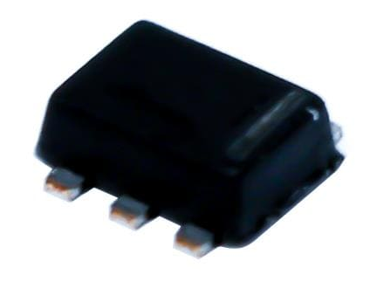
Major Components
Power Regulation
Buck Converter: TPS563231DRLT
Specs:
Input range 4.5V-17V
Output 3.3V
Max Current 3A
Usage:
This will be used to step down USB 5V input to 3.3V that will power the main keyboard (stm32f4) as well as submodules via the hotplug connection

Slide 7
Major Components
Power Regulation
Voltage Regulator: [Insert Name]
Specs:
sdf
Usage:
sdf

Slide 8
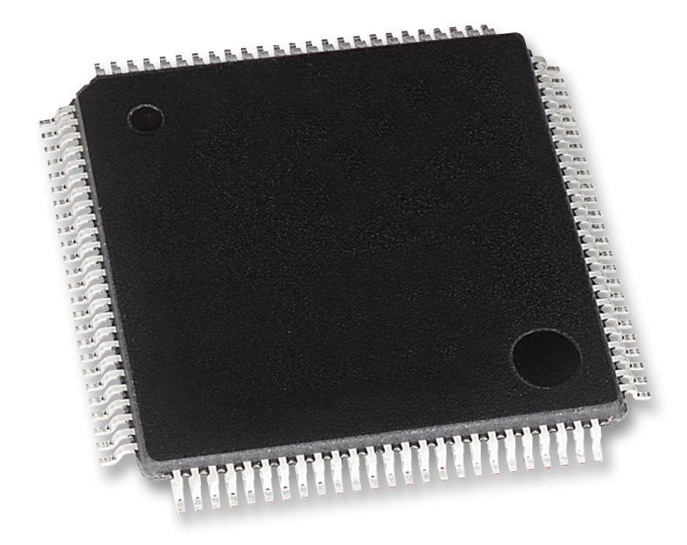
Major Components
Microcontrollers
Main Keyboard MCU: STM32F407VGT6
Specs:
USB FS Controller
I2C
GPIO
Usage:
This MCU will be used to communicate with the host PC over USB and to submodules over I2C. It will also scan the key matrix with GPIO

Slide 9
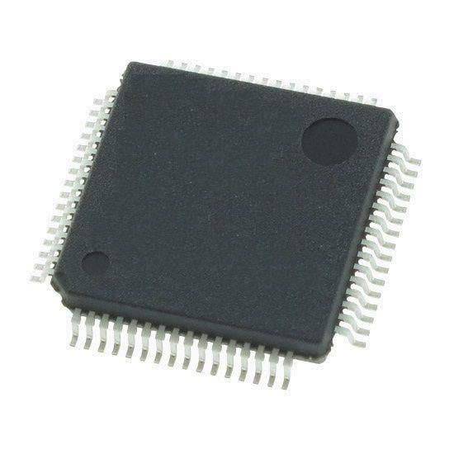
Major Components
Microcontrollers
Main Keyboard MCU: STM32F091RCT6
Specs:
I2C
SPI
Usage:
This MCU will be used to communicate with the SPI TFT LCD display to draw info and to the main keyboard over I2C over the hotplug connector.

Slide 10
Block Diagram
Include one or more images of your system block diagram here. Block diagrams should include all relevant major parts and systems, bus widths, and interface types.

Slide 11
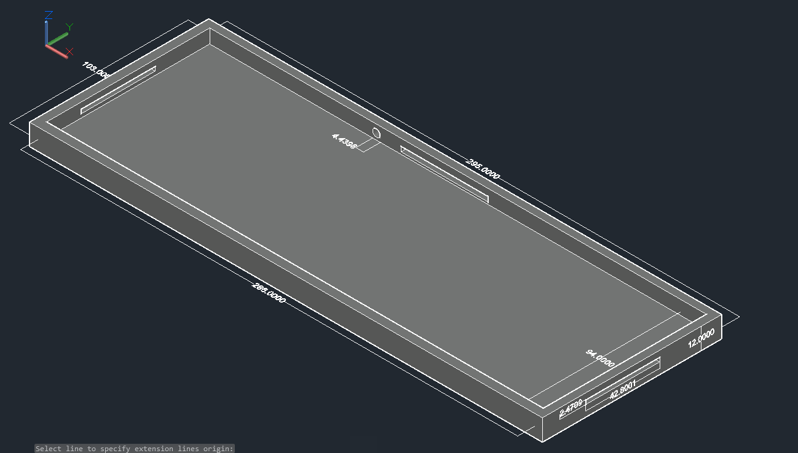
Packaging Design
Main Keyboard Original Design
Outer layer 295x103x12 mm
Inner layer 286x94x8 mm
3 access points to allow it to connect to other modules, and a point of access to connect to the USB port.
Keyboard has evolved, but the packaging design will remain fairly similar

Slide 12
Packaging Design
Peripheral Module
Include one or more images of your packaging design here. Include relevant dimensions and how you are planning to manufacture your product packaging.
We plan to use laser cut acrylic sheets to mount both keyboard modules

Slide 13
Electrical Schematic
Include one or more views of your electrical schematic here. If necessary, break up this section into multiple slides detailing various subsystems which are easily viewable (Hint: a zoomed out view of a large electrical schematic in which nothing can be read will not be helpful for the design review). Your schematics should be complete, organized, and readable.

Slide 14
PCB Layout
Include one or more views of your PCB Layout here. If necessary, break up this section into multiple slides detailing various subsystems which are easily viewable (Hint: a zoomed out view of a large electrical schematic in which nothing can be read will not be helpful for the design review). Your layout should be complete, organized, and readable.

Slide 15
Prototyping Progress
Describe your team’s prototyping progress here. For each of your project’s major components, what has been tested? What is known to work? What still needs to be tested, and what still needs to be proven to work?

Slide 16
Software Development Status
In this section, detail team progress with software development. List out the major modules for your team’s software. For each module, detail its status (Not yet started / In development / In testing / Completed)
Keyboard Scanning and Debouncing (In development)

Slide 17
Project Timeline
Provide a timeline (or GANTT chart, etc.), starting from the current week until the end of the semester, detailing work to be undertaken in completing your team’s project.

Slide 18
3D Printing
Questions?

